Slide 1

Michael Jordan’s Performance with the Chicago Bulls
Final Capstone Project | Thinkful | October 2021
Pedro Morales

Slide 2
Why it matters?
Michael Jordan is one of the greatest basketball players of all time, we already have some insights into his stats, but have we considered others approaches to understand his performance?

Slide 3
Which Questions?
Was Michael Jordan’s game score performance any different when playing against any team?
Did Michael Jordan make more 3 points goal field shots when playing on the home field?

Slide 4



Michael Jordan’s Key Metrics 1985-93, 95-98
930 Games Played
24.87 Average Game Score
630 Games Won

Slide 5
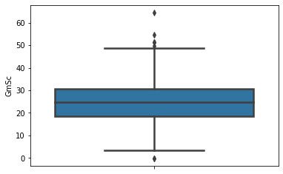
Game Score Descriptive Statistics
Count 930.000000
Mean 24.873333
Std 8.840941
Min -0.400000
25% 18.500000
50% 24.600000
75% 30.575000
Max 64.600000

Slide 6
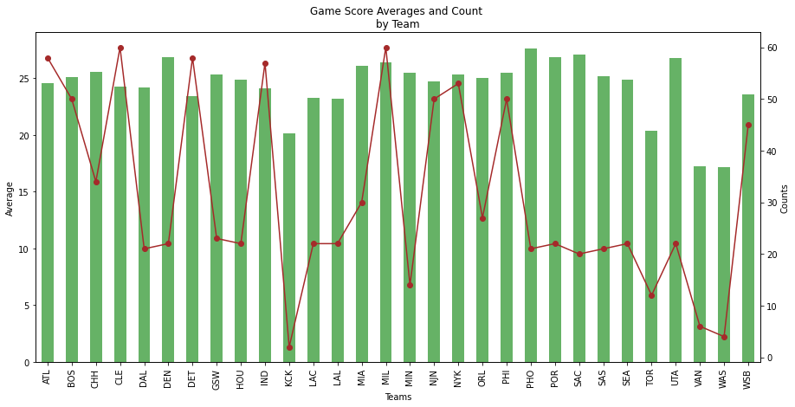
Detroit and Milwaukee Meet Our Criteria

Slide 7
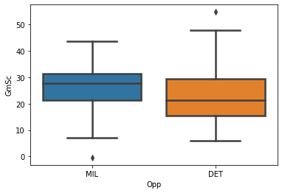
Detroit and Milwaukee
Since there’s overlap between the bands, with a 95% confidence interval, we are certain, statistically, that there’s no significant game score average difference between the two.

Slide 8
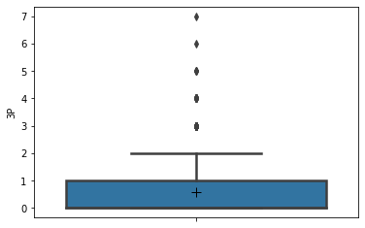
3P Descriptive Statistics
Count 930.000000
Mean 0.596774
Std 1.012192
Min 0.000000
25% 0.000000
50% 0.000000
75% 1.000000
Max 7.000000

Slide 9
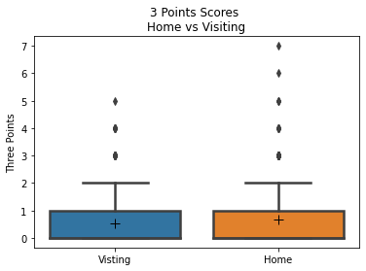
3P When Playing Home field vs Visiting
Here we can be certain, with a 95% confidence, that there is no statistical difference between 3 points goal field shots made on its home field and as a visiting team.

Slide 10
In this research we’ve concluded that Jordan’s performance was statistically the same in terms of game score and 3 points shots
We have now a new perspective into Jordan’s performance, but this doesn’t have to end here…

Slide 11

Thanks!
Any questions?

